Slide 1
LEADS CASE STUDY
bY
Amish Deshpande

Slide 2
Problem Statement
X Education is an online training platform that provides training to industry professionals.
X Education lead conversion rate is very poor though they have a lot of enquires.
The company wishes to identify the most potential leads and increase their rate of lead conversion.
Their aim is to identify a set of leads, and convert them to coustmers using different means.

Slide 3
Goal
X Education requires a model where its leads are converted to costumers.
They need recommendation as to how to convert the leads .

Slide 4
Steps Adopted
Sourcing and Importing data
Cleaning and preparing data for analysis
Using EDA for further analysis
Scaling the features
Preparing data for model building
Splitting the data
Building a logistic model
Evaluating the model
Measuring the accuracy

Slide 5
Methodology
Sourcing and Cleaning
*Convert and clean data for analysis
*Remove duplicate data
2) Scaling and Spliting the data
3) Model Building
*By using logistic regression select the suitable model
*Selecting a suitable feature using RFE
*calculate accuracy, sensitivity, specificity
4) Result
*Determine the final score and prediction
*Evaluate the prediction and result

Slide 6
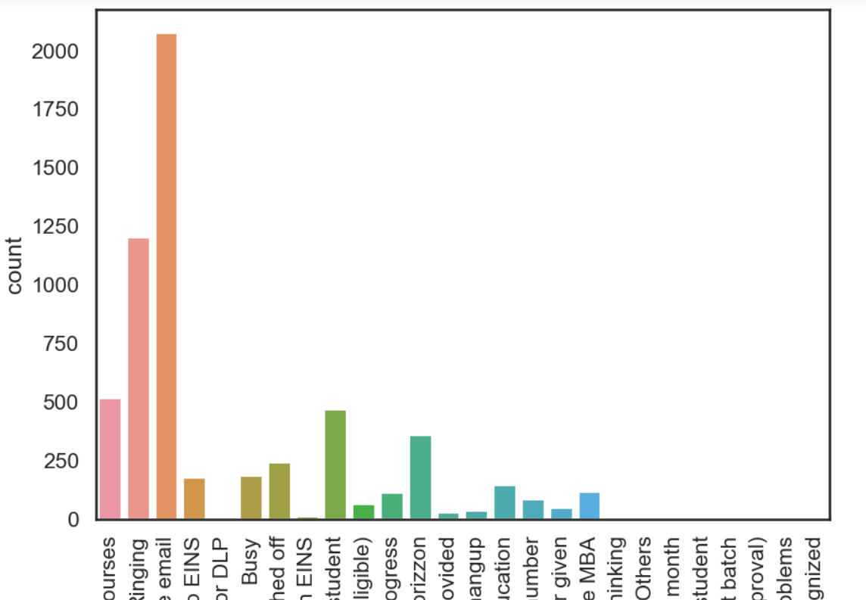
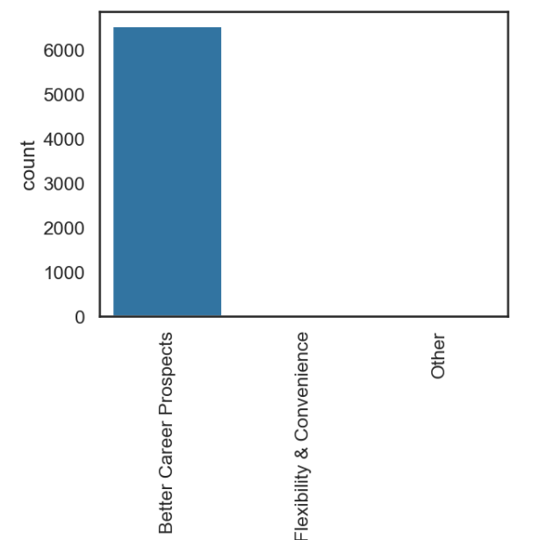
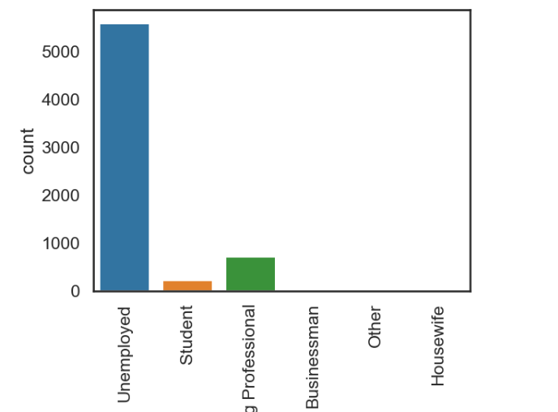
Exploratory Data Analysis
This shows emails have high no of responses
This also shows people who get converted to costumers
also take these confirmation before taking up the course

Slide 7
Variables
Do not Email
Total Visits
Total time spent on website
Lead Origin – Lead page submission
Lead Origin – Lead add form
Lead Source – Chat
Last Source – Welingak Website
Last Activity – Email Bounced, Not sure, chat, sms
Current Occupation- No Info, Working Professional
Last Notable Activity – Phone conversation, Unreachable

Slide 8
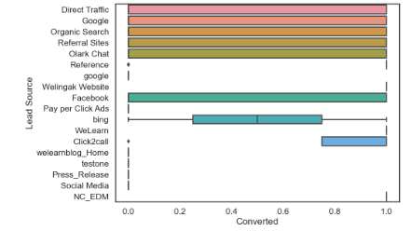
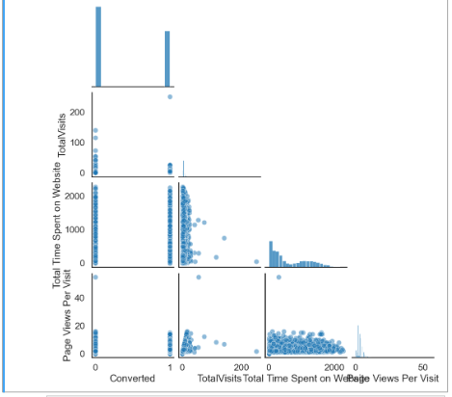
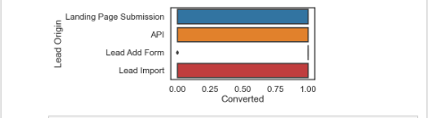
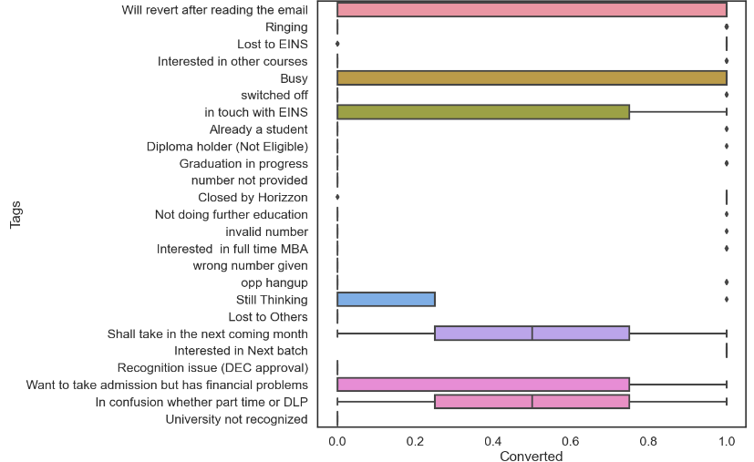
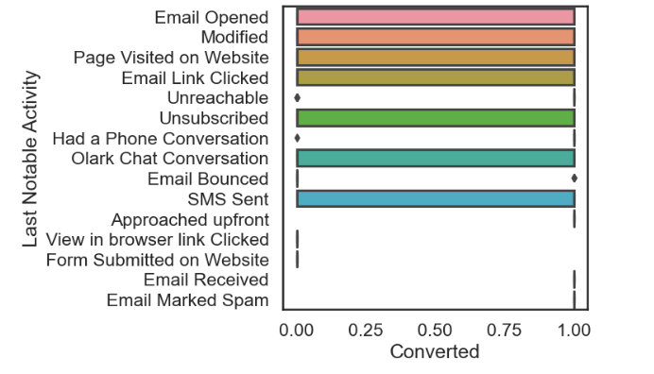
This shows origin of lead conversion
This shows the lead sources of conversion
This shows how leads get
converted by time spent on website
These show the conversion rate with most reverts received with folllowups and tags

Slide 9
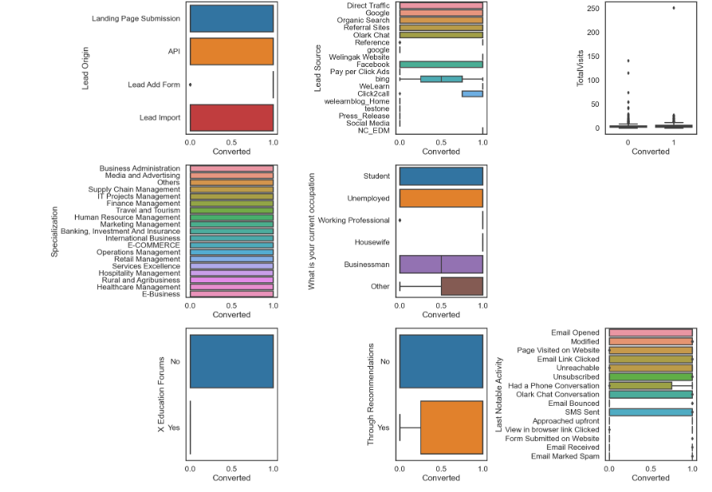
This shows a whole map of specifics for conversion

Slide 10
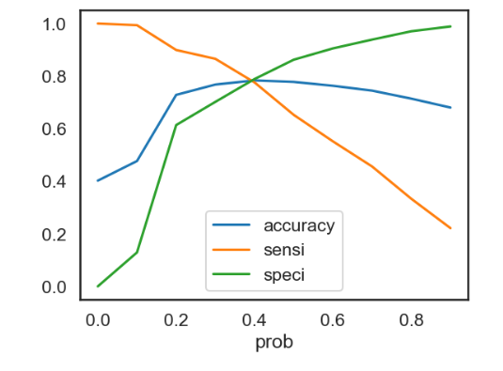

Model Evaluation
The Graph shows cutoff of 0.4 based on accuracy, sensitivity and specificity

Slide 11
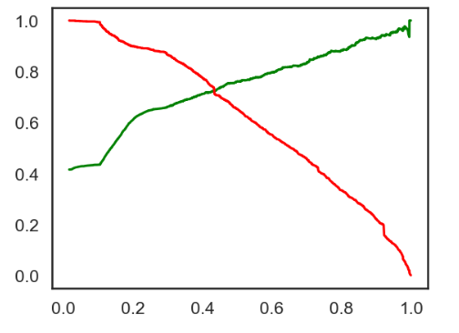
The Graph shows an optimal cutoff of 0.45

Slide 12
Conclusion
Sensitivity-Specificity, Precision and Recall Metrics, optimal cut off.
Accuracy, Sensitivity and Specificity values of test set are around 72%, 79% which are approximately closer to the respective values calculated using trained set.
Also the lead score calculated shows the conversion rate on the final predicted model is around 58%
The top 3 variables that contribute for lead getting converted in the model are Total time spent on website, Lead Add Form from Lead Origin, Had a Phone Conversation from Last Notable Activity, Hence overall this model seems to be good.

